Slide 1

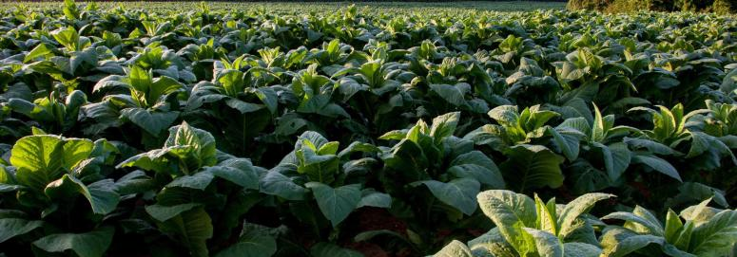
AGRICULTURE
MANAGEMENT
SYSTEM
PRESENTATION

Slide 2

INTRODUCTION
01.
TO AGRICULTURAL
DATABASE
Table Of
Contents
CREATION OF
ER DIAGRAM
02.
ER DIAGRAM TO TABLES
03.

Slide 3
04.
QUERIES
Table Of
Contents
NORMALIZATION
OF TABLE
05.
06.
VIEWS

Slide 4

01.
Introduction

Slide 5
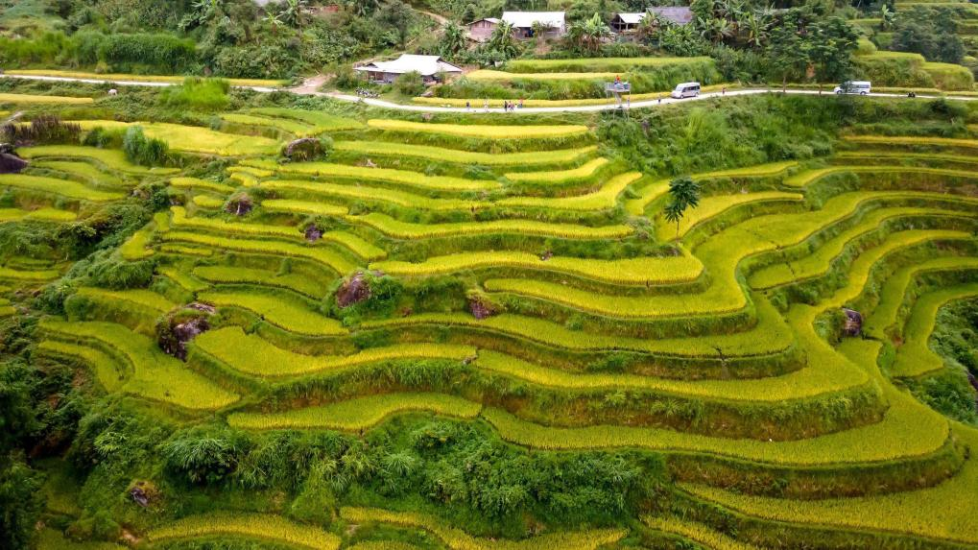
An agricultural management system is a comprehensive approach to managing various aspects of agricultural operations, often with the aid of technology.
This data helps farmers make informed decisions about irrigation, fertilization, pest control, and harvesting. improve productivity and efficiency, reduce costs, ensure and promote sustainability for long-term success in agriculture.

Slide 6
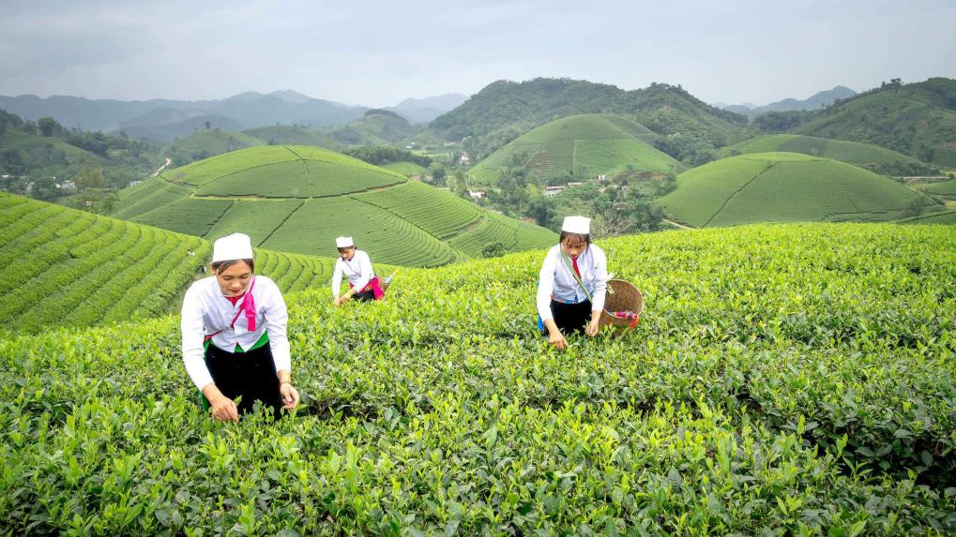
02.
Creation of ER Diagram

Slide 7
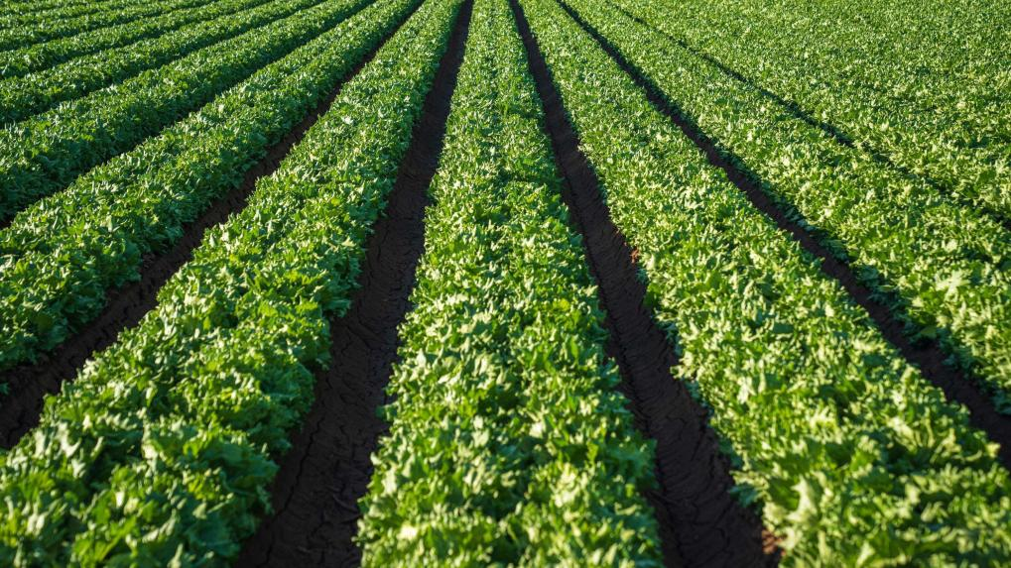
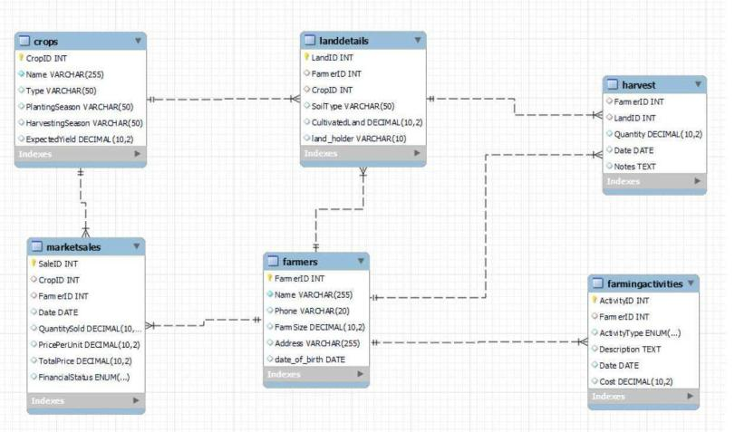
ER DIAGRAM

Slide 8
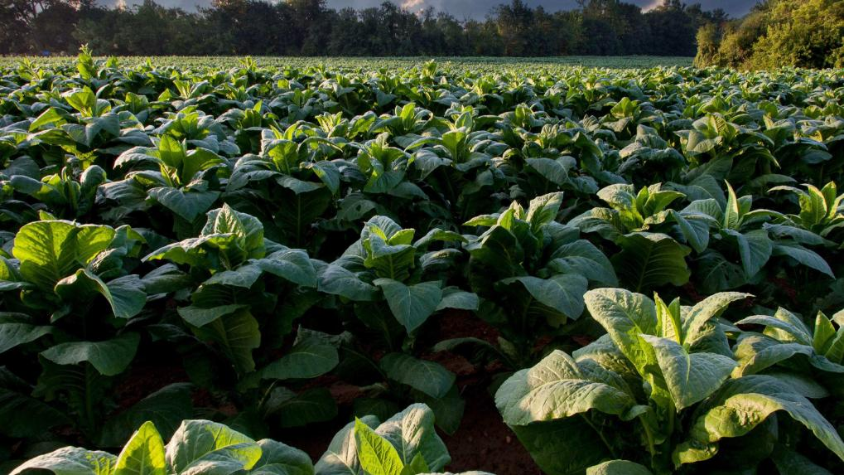
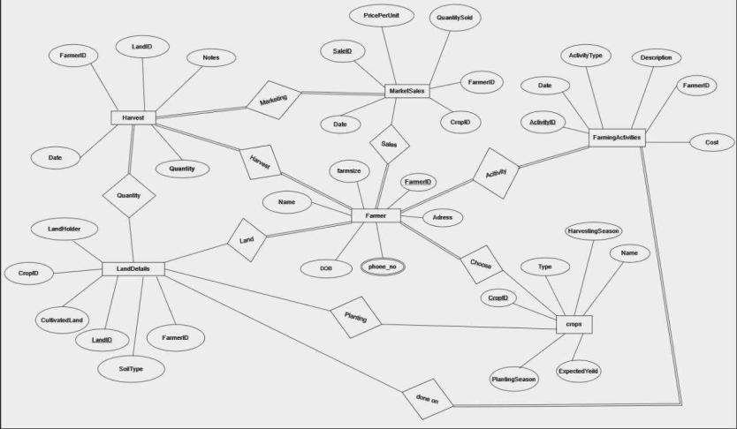
ER DIAGRAM

Slide 9
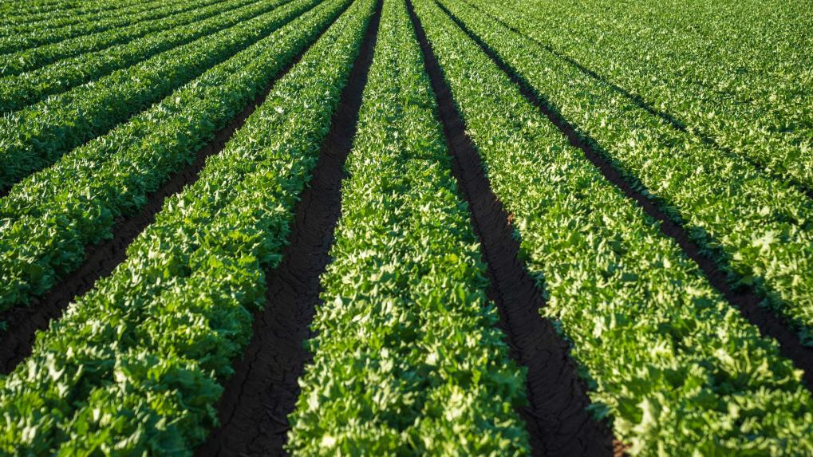
03.
ER DIAGRAM TO TABLES

Slide 10
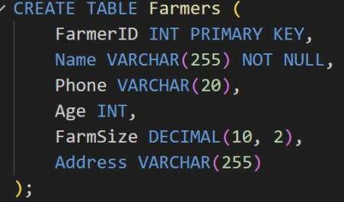
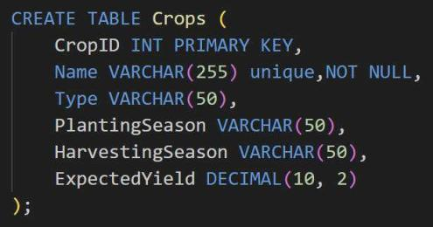
TABLES

Slide 11
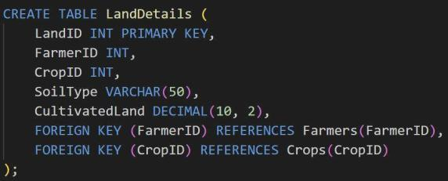
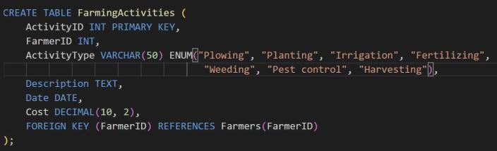
TABLES

Slide 12
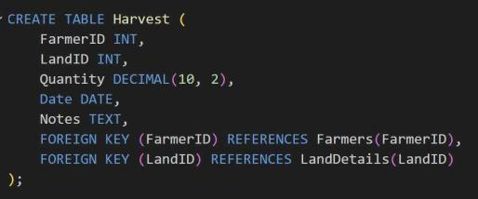
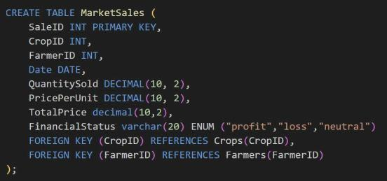
TABLES

Slide 13
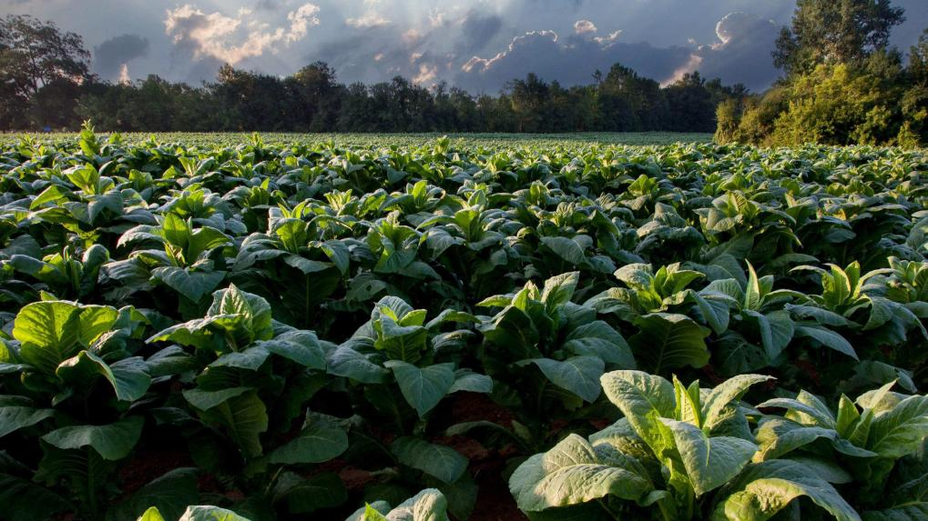
04.
QUERIES

Slide 14


QUERIES
In a Database Management System (DBMS), a query is a request for information from a database. It's a command or a set of commands used to retrieve, manipulate, insert, or delete data from a data.
QUERIES ON :
Sub query
Aggregate functions
Joins

Slide 15


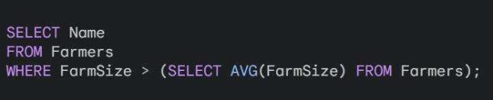
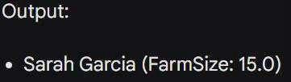
SUB QUERY
Query 1: Retrieve the names of farmers who have a FarmSize greater than the average FarmSize.

Slide 16
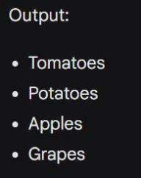






Query 2: Retrieve the names of crops that have an
ExpectedYield greater than the average

Slide 17





AGGREGATE FUNCTION
Query 3: Calculate the average
ExpectedYield for all crops

Slide 18
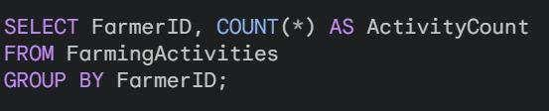
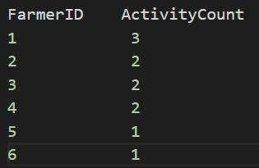
Query 4: Count the number of farming activities for each farmer.

Slide 19
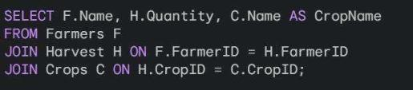
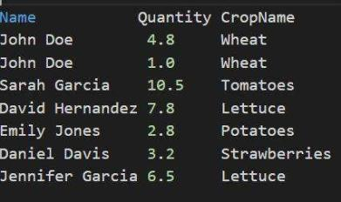
Query 5: Retrieve the total quantity of harvest and the corresponding crop names for each farmer.
JOINS

Slide 20
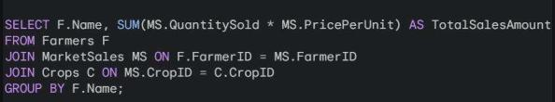
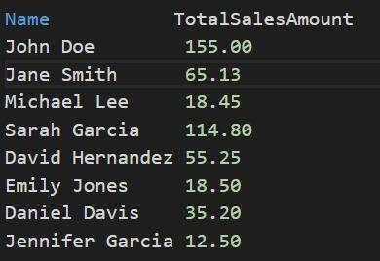
Query 6: Retrieve the total sales amount for each
farmer by joining MarketSales and Crops tables.

Slide 21
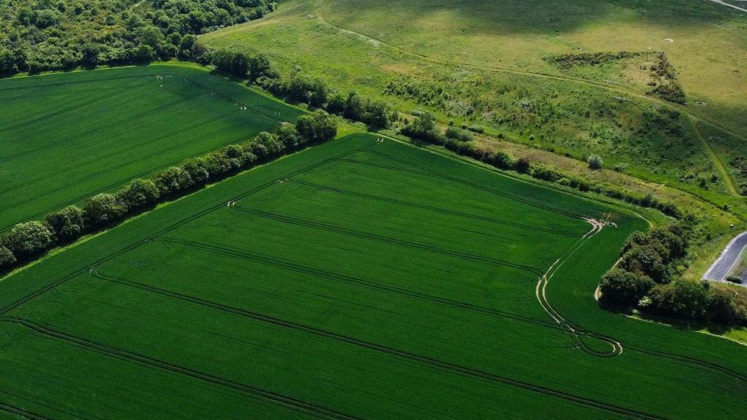
05.
NORMALIZATION

Slide 22
NORMALIZATION
Normalization is the process of organizing data in a database efficiently by reducing redundancy and dependency. It involves breaking down large tables into smaller, more manageable ones and establishing relationships between them to minimize data duplication and ensure data integrity.

Slide 23


NORMALIZATION
TYPES
First Normal Form (1NF):-Ensure each cell in a table holds a single, atomic
value.
Second Normal Form (2NF):-Remove partial dependencies by ensuring non- key attributes are fully dependent on the entire primary key.
Third Normal Form (3NF):Eliminate transitive dependencies by ensuring non-key attributes are not dependent on other non-key attributes.

Slide 24
NORMALIZATION OF TABLES
First Normal Form (1NF):
All tables are in 1NF. This meansEach cell contains a single atomic value.There are no repeating groups within a table.All columns have unique names.
Second Normal Form (2NF):
All tables are likely in 2NF except LandDetails and Harvest tables. However, a definitive analysis requires examining functional dependencies (relationships between attributes).
Third Normal Form (3NF):
We need to analyze potential partial and transitive dependencies to determine if
the tables are in 3NF

Slide 25
NORMALIZATION OF TABLES
SOLUTIONS
Decompose LandDetails into two tables
FarmerLand: (FarmerID, LandID, SoilType) - This table captures the relationship between farmers and their land
parcels.
LandCrops: (LandID, CropID, CultivatedLand) - This table links land parcels with crops grown on them and the cultivated area.
Harvest:A partial dependency might exist: Quantity might depend on LandID (indirectly through FarmerID).
Decompose Harvest into two tables:
FarmerHarvest: (FarmerID, Date, Quantity, Notes) - This table captures the overall harvest details for a
farmer.
LandHarvestDetails: (LandID, CropID, Date, Quantity, Notes) - This table links specific land parcels and crops with the harvested quantity for each.

Slide 26

06.
VIEWS

Slide 27
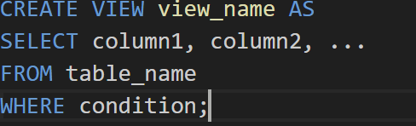
VIEWS
Data Abstraction
In a Database Management System (DBMS), a view is a virtual table that is based on the result set of a SELECT query. Views don't store data themselves; instead, they display data from one or more tables in the database. They are essentially stored queries that can be referenced as if they were tables.
Security
Data Integrity
SYNTAX
Updatability

Slide 28


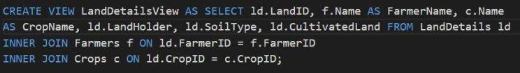
Farmers
view
Crops view
Landdetails
view

Slide 29
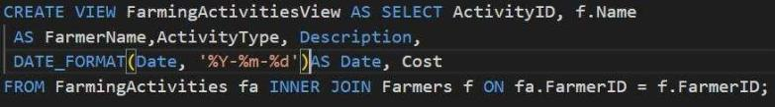
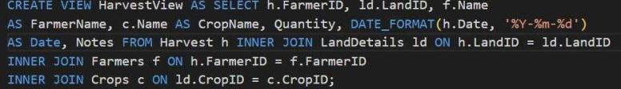

Farming
Activity
Harvest View
Marketsales view

Slide 30




THANK YOU
AP22110010255 – ACHYUTH B AP22110010216 – RAGHU RAM M AP22110010238 – NARSIMHA D AP22110010262 - ANJANEYULU B

